Slide 1
GUESTBOOK
Table design

Slide 2
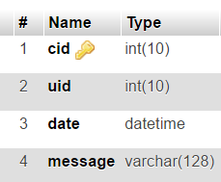
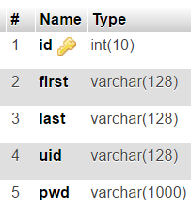
Relational Schema
Table: comments
Table: users

